Slide 1

Date:- 18/10/2021
Project Title | P75- Summary Extraction along with sentiment analysis.
Team Members | Manan Malhotra
 | Chagam Nandini
 | Renu Rawat
 | Rohit Pawar
 | Shubham Patel
Project Guide | Mr. Parth Sagar

Slide 2
Business Problem:
Business Objective : Summary Extraction along with sentiment analysis.
Objective:
To extract summary from E-book of your choice, categorize summary as positive, negative or neutral. Build a NLP model to achieve the said objective with accepted accuracy of 75% and above.

Slide 3

Project Architecture/Project Flow
Business Problem
Data Collection
EDA
Model Building
Data Pre-Porcessing
Model Evaluation
Model Development

Slide 4
Exploratory Data Analysis
Why EDA ?
Exploratory Data Analysis refers to the critical process of performing initial investigations on data so as to discover patterns, to spot anomalies, to test hypothesis and to check assumptions with the help of summary statistics and graphical representations.

Slide 5
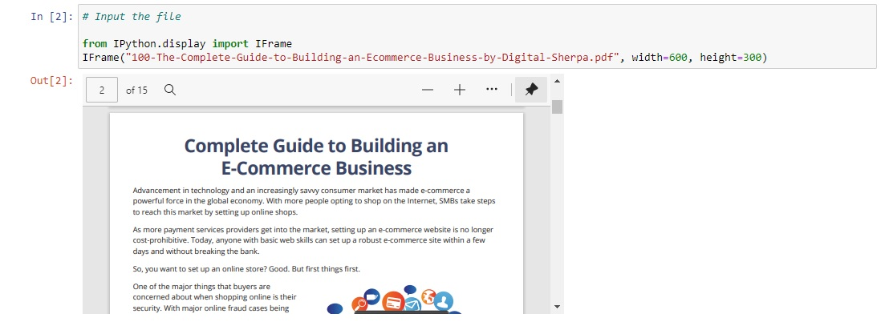
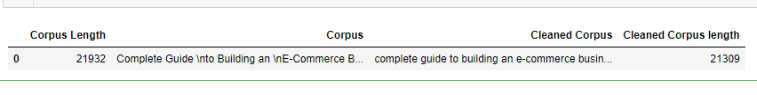
Data Set
Data Cleaning

Slide 6
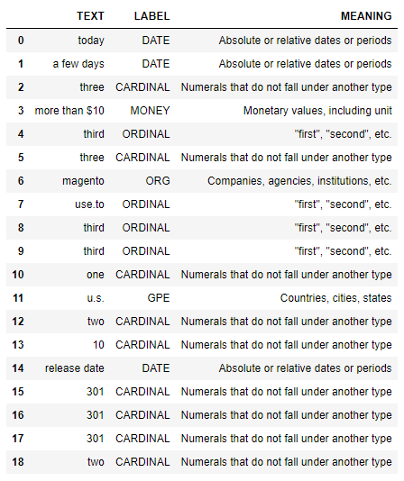
Named Entity Recognition

Slide 7
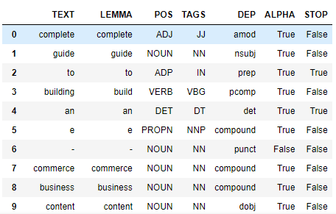
Parts of Speech & Dependency

Slide 8
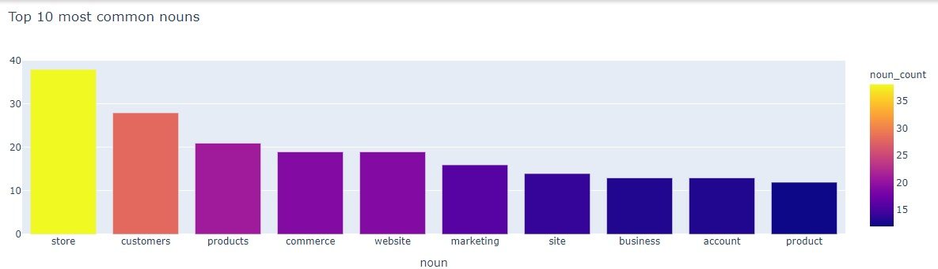
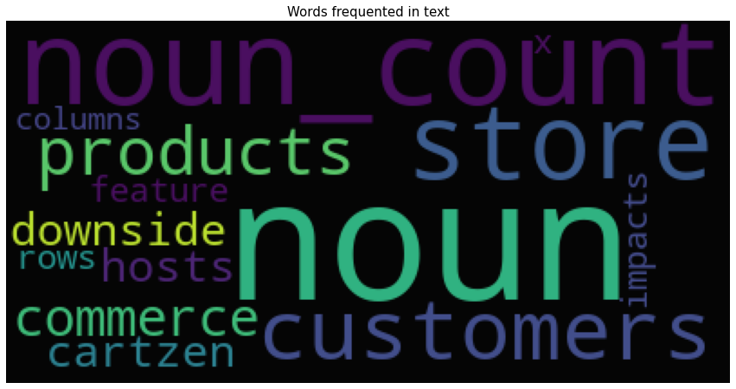
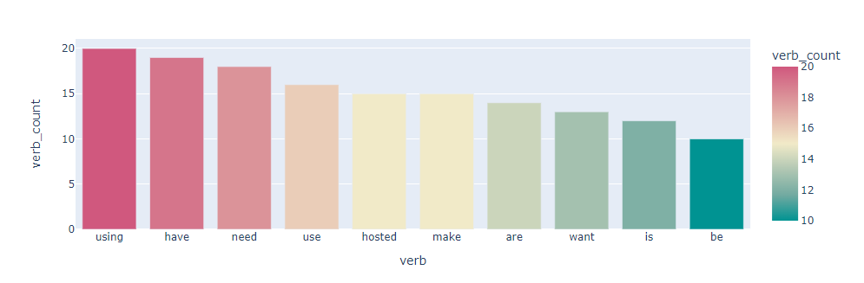
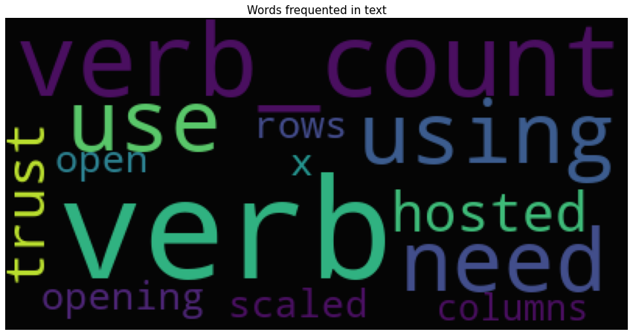
Verb Extraction
Noun Extraction

Slide 9
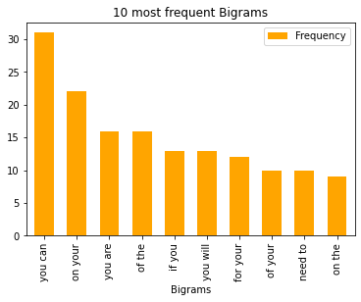
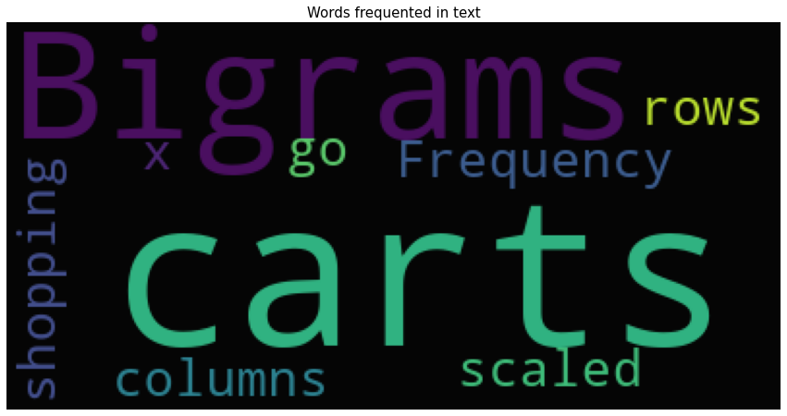
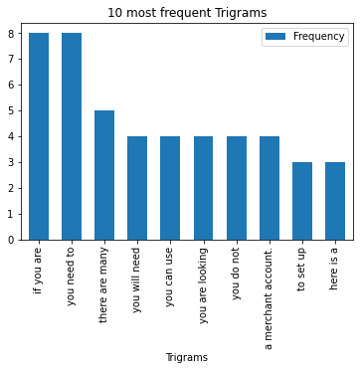
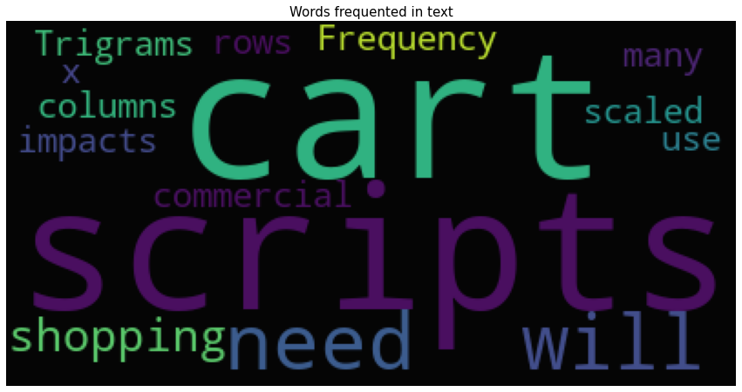
Bigrams
Trigrams

Slide 10
Model Building

Slide 11
Model Details
Summarizer : Extractive
Sumy summarizers
Gensim summarizer
Abstractive Summarizer:
Transformer summarizers
Automatic Summarizers
Data set details
Ecommerce_Business_Guide.pdf
Data details
Corpus - Extracted text data from ebook pdf
NLP Models
TF IDF Vectorizer – Sklearn

Slide 12
Model Results
Generated summaries using Automatic Summarizers and NLP models.
Summary Evaluation was done using Rouge Score. Summaries generated from the various NLP models were compared with the summaries generated by the Automatic Summarizer.
Implementation of Tf-Idf Vectorizer model was done for summary generation.
Sentiment analysis was done on the generated summary

Slide 13
Automatic Summarizers
NLP Models - Extractive Text Summarizer
LexRank Summarizer
Luhn Summarizer
LSA Summarizer
TextRank Summarizer
Edmundson Summarizer
Reduction Summarizer
Gensim Summarizer
T5 Summarizer
TF-IDF Vectorizer – Sklearn

Slide 14
TF-IDF Vectorizer - Sklearn
Input Corpus
Tokenize Sentence
TF-IDF Vectorizer
Summary
Select Top 5 Sentence Score
Sum TF-IDF Scores

Slide 15
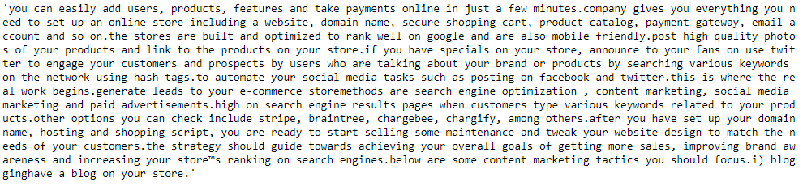

Summary Generated
Sentiment Analysis

Slide 16
Model Evaluation – Using Rouge Score
Model Summery | Reference Summery (automatic summarizers) | Rouge-1 {R/P/F(%)} | Rouge-2 {R/P/F(%)} | Rouge-L {R/P/F(%)}
TF-IDF Vectorizer –Sklearn | Reduction Summarizer Edmondson Summarizer | 89/87/88 77/76/77 | 82/83/83 66/70/68 | 89/87/88 77/75/76

Slide 17
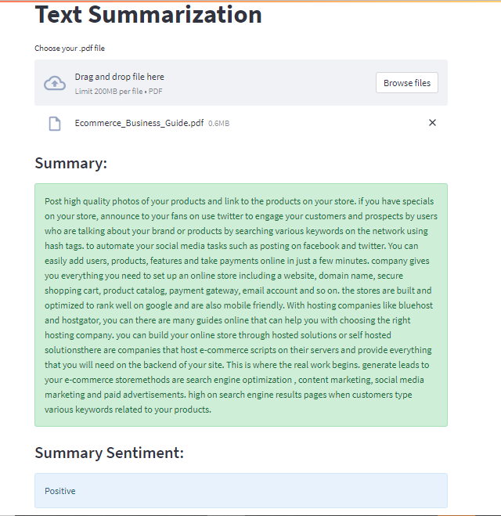
Model Deployment using Streamlit & Github

Slide 18
Feedback
Challenges faced?
For evaluation of Tf-Idf vectorizer model we were not getting any reference summary for the E-book
Accuracy for Tf-Idf vectorizer model was coming below 75%
How did you overcome?
We used summaries generated from the automatic summarizer as reference summary
Instead of unigrams we used bigrams in Tf-Idf vectorizer and the accuracy improved to 89%

Slide 19
Thank you

